Slide 1
Monopoly
© 2015 Cengage Learning. All Rights Reserved. May not be copied, scanned, or duplicated, in whole or in part, except for use as permitted in a license distributed with a certain product or service or otherwise on a password-protected website for classroom use.

Slide 2
Why Monopolies Arise
Market power
  Alters the relationship between a firm’s costs and the selling price
Monopoly
  Charges a price that exceeds marginal cost
  A high price reduces the quantity purchased
  Outcome: often not the best for society
© 2015 Cengage Learning. All Rights Reserved. May not be copied, scanned, or duplicated, in whole or in part, except for use as permitted in a license distributed with a certain product or service or otherwise on a password-protected website for classroom use.

Slide 3
Why Monopolies Arise
Governments
  Can sometimes improve market outcome
Monopoly
  Firm that is the sole seller of a product without close substitutes
  Price maker
  Cause: barriers to entry
© 2015 Cengage Learning. All Rights Reserved. May not be copied, scanned, or duplicated, in whole or in part, except for use as permitted in a license distributed with a certain product or service or otherwise on a password-protected website for classroom use.

Slide 4
Why Monopolies Arise
Barriers to entry
  A monopoly remains the only seller in the market
    Because other firms cannot enter the market and compete with it
  Monopoly resources
  Government regulation
  The production process
© 2015 Cengage Learning. All Rights Reserved. May not be copied, scanned, or duplicated, in whole or in part, except for use as permitted in a license distributed with a certain product or service or otherwise on a password-protected website for classroom use.

Slide 5
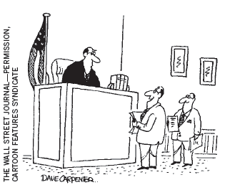
Why Monopolies Arise
Monopoly resources
  A key resource required for production is owned by a single firm
  Higher price
“Rather than a monopoly, we like to consider ourselves ‘the only game in town.’”
© 2015 Cengage Learning. All Rights Reserved. May not be copied, scanned, or duplicated, in whole or in part, except for use as permitted in a license distributed with a certain product or service or otherwise on a password-protected website for classroom use.

Slide 6
Why Monopolies Arise
Government regulation
  Government gives a single firm the exclusive right to produce some good or service
  Government-created monopolies
    Patent and copyright laws
    Higher prices
    Higher profits
© 2015 Cengage Learning. All Rights Reserved. May not be copied, scanned, or duplicated, in whole or in part, except for use as permitted in a license distributed with a certain product or service or otherwise on a password-protected website for classroom use.

Slide 7
Why Monopolies Arise
Natural monopoly
  A single firm can supply a good or service to an entire market
    At a smaller cost than could two or more firms
  Economies of scale over the relevant range of output
  Club goods
    Excludable but not rival in consumption
© 2015 Cengage Learning. All Rights Reserved. May not be copied, scanned, or duplicated, in whole or in part, except for use as permitted in a license distributed with a certain product or service or otherwise on a password-protected website for classroom use.

Slide 8
Figure 1
Economies of Scale as a Cause of Monopoly
Costs
Average total cost
0
Quantity of output
When a firm’s average-total-cost curve continually declines, the firm has what is called a natural monopoly. In this case, when production is divided among more firms, each firm produces less, and average total cost rises. As a result, a single firm can produce any given amount at the least cost
© 2015 Cengage Learning. All Rights Reserved. May not be copied, scanned, or duplicated, in whole or in part, except for use as permitted in a license distributed with a certain product or service or otherwise on a password-protected website for classroom use.

Slide 9
Production and Pricing Decisions
Monopoly
  Price maker
  Sole producer
  Downward sloping demand: the market demand curve
Competitive firm
  Price taker
  One producer of many
  Demand is a horizontal line (Price)
© 2015 Cengage Learning. All Rights Reserved. May not be copied, scanned, or duplicated, in whole or in part, except for use as permitted in a license distributed with a certain product or service or otherwise on a password-protected website for classroom use.

Slide 10
Figure 2
Demand Curves for Competitive and Monopoly Firms
(a) A Competitive Firm’s Demand Curve
(b) A Monopolist’s Demand Curve
Price
Price
Demand
Demand
0
Quantity of output
0
Quantity of output
Because competitive firms are price takers, they in effect face horizontal demand curves, as in panel (a). Because a monopoly firm is the sole producer in its market, it faces the downward-sloping market demand curve, as in panel (b). As a result, the monopoly has to accept a lower price if it wants to sell more output.
© 2015 Cengage Learning. All Rights Reserved. May not be copied, scanned, or duplicated, in whole or in part, except for use as permitted in a license distributed with a certain product or service or otherwise on a password-protected website for classroom use.

Slide 11
Production and Pricing Decisions
A monopoly’s total revenue
  Total revenue = price times quantity
A monopoly’s average revenue
  Revenue per unit sold
  Total revenue divided by quantity
  Always equals the price
© 2015 Cengage Learning. All Rights Reserved. May not be copied, scanned, or duplicated, in whole or in part, except for use as permitted in a license distributed with a certain product or service or otherwise on a password-protected website for classroom use.

Slide 12
Production and Pricing Decisions
A monopoly’s marginal revenue
  Revenue per each additional unit of output
    Change in total revenue when output increases by 1 unit
  MR < P
    Downward-sloping demand
    To increase the amount sold, a monopoly firm must lower the price it charges to all customers
  Can be negative
© 2015 Cengage Learning. All Rights Reserved. May not be copied, scanned, or duplicated, in whole or in part, except for use as permitted in a license distributed with a certain product or service or otherwise on a password-protected website for classroom use.

Slide 13
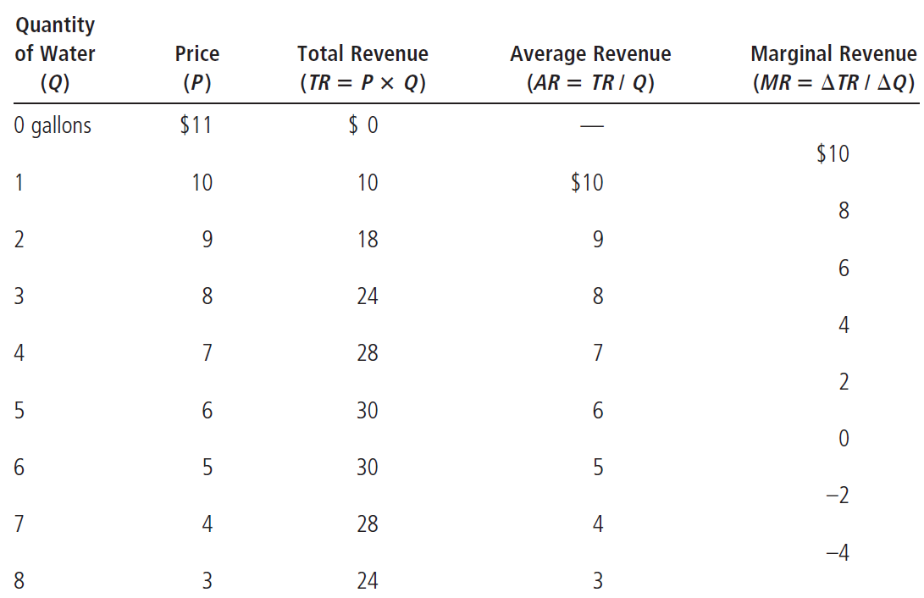
Table 1
A Monopoly’s Total, Average, and Marginal Revenue
© 2015 Cengage Learning. All Rights Reserved. May not be copied, scanned, or duplicated, in whole or in part, except for use as permitted in a license distributed with a certain product or service or otherwise on a password-protected website for classroom use.

Slide 14
Production and Pricing Decisions
Increase in quantity sold
  Output effect
    Q is higher: increase total revenue
  Price effect
    P is lower: decrease total revenue
Because MR < P
  Marginal-revenue curve is below the demand curve
© 2015 Cengage Learning. All Rights Reserved. May not be copied, scanned, or duplicated, in whole or in part, except for use as permitted in a license distributed with a certain product or service or otherwise on a password-protected website for classroom use.

Slide 15
Figure 3
Demand and Marginal-Revenue Curves for a Monopoly
Price
$11
10
9
8
7
6
5
4
3
Demand
(average revenue)
2
1
0
-1
1
2
3
4
5
6
7
8
Quantity
of water
-2
-3
-4
Marginal revenue
The demand curve shows how the quantity affects the price of the good. The marginal-revenue curve shows how the firm’s revenue changes when the quantity increases by 1 unit. Because the price on all units sold must fall if the monopoly increases production, marginal revenue is always less than the price.
© 2015 Cengage Learning. All Rights Reserved. May not be copied, scanned, or duplicated, in whole or in part, except for use as permitted in a license distributed with a certain product or service or otherwise on a password-protected website for classroom use.

Slide 16
Production and Pricing Decisions
Profit maximization
  If MR > MC: increase production
  If MC > MR: produce less
  Maximize profit
    Produce quantity where MR=MC
    Intersection of the marginal-revenue curve and the marginal-cost curve
    Price: on the demand curve
© 2015 Cengage Learning. All Rights Reserved. May not be copied, scanned, or duplicated, in whole or in part, except for use as permitted in a license distributed with a certain product or service or otherwise on a password-protected website for classroom use.

Slide 17
Figure 4
Profit Maximization for a Monopoly
Costs
and
Revenue
2. . . . and then the demand curve shows the price consistent with this quantity.
Marginal cost
Monopoly
price
B
Average total cost
A
Demand
1. The intersection of the marginal-revenue curve and the marginal-cost curve determines the profit-maximizing quantity . . .
Marginal revenue
0
Q₁
Q_{MAX}
Q₂
Quantity
A monopoly maximizes profit by choosing the quantity at which marginal revenue equals marginal cost (point A). It then uses the demand curve to find the price that will induce consumers to buy that quantity (point B).
© 2015 Cengage Learning. All Rights Reserved. May not be copied, scanned, or duplicated, in whole or in part, except for use as permitted in a license distributed with a certain product or service or otherwise on a password-protected website for classroom use.

Slide 18
Production and Pricing Decisions
Profit maximization
  Perfect competition: P=MR=MC
    Price equals marginal cost
  Monopoly: P>MR=MC
    Price exceeds marginal cost
A monopoly’s profit
  Profit = TR – TC = (P – ATC) ˣ Q
© 2015 Cengage Learning. All Rights Reserved. May not be copied, scanned, or duplicated, in whole or in part, except for use as permitted in a license distributed with a certain product or service or otherwise on a password-protected website for classroom use.

Slide 19
Figure 5
The Monopolist’s Profit
Costs
and
Revenue
Marginal cost
Monopoly
price
E
B
Average total cost
Monopoly
profit
Average
total
cost
Demand
D
C
Marginal revenue
0
Q_{MAX}
Quantity
The area of the box BCDE equals the profit of the monopoly firm. The height of the box (BC) is price minus average total cost, which equals profit per unit sold. The width of the box (DC) is the number of units sold.
© 2015 Cengage Learning. All Rights Reserved. May not be copied, scanned, or duplicated, in whole or in part, except for use as permitted in a license distributed with a certain product or service or otherwise on a password-protected website for classroom use.

Slide 20
Monopoly Drugs versus Generic Drugs
Market for pharmaceutical drugs
  New drug, patent laws, monopoly
    Produce Q where MR=MC
    P>MC
  Generic drugs: competitive market
    Produce Q where MR=MC
    And P=MC
Price of the competitively produced generic drug
  Below the monopolist’s price
© 2015 Cengage Learning. All Rights Reserved. May not be copied, scanned, or duplicated, in whole or in part, except for use as permitted in a license distributed with a certain product or service or otherwise on a password-protected website for classroom use.

Slide 21
Figure 6
The Market for Drugs
Costs
and
Revenue
Price
during
patent life
Price after
patent
expires
Marginal cost
Demand
Marginal revenue
0
Monopoly
quantity
Competitive
quantity
Quantity
When a patent gives a firm a monopoly over the sale of a drug, the firm charges the monopoly price, which is well above the marginal cost of making the drug. When the patent on a drug runs out, new firms enter the market, making it more competitive. As a result, the price falls from the monopoly price to marginal cost.
© 2015 Cengage Learning. All Rights Reserved. May not be copied, scanned, or duplicated, in whole or in part, except for use as permitted in a license distributed with a certain product or service or otherwise on a password-protected website for classroom use.

Slide 22
The Welfare Cost of Monopolies
Total surplus
  Economic well-being of buyers and sellers in a market
  Sum of consumer surplus and producer surplus
Consumer surplus
  Consumers’ willingness to pay for a good
  Minus the amount they actually pay for it
© 2015 Cengage Learning. All Rights Reserved. May not be copied, scanned, or duplicated, in whole or in part, except for use as permitted in a license distributed with a certain product or service or otherwise on a password-protected website for classroom use.

Slide 23
The Welfare Cost of Monopolies
Producer surplus
  Amount producers receive for a good
  Minus their costs of producing it
Benevolent planner: maximize total surplus
  Socially efficient outcome
  Produce quantity where
    Marginal cost curve intersects demand curve
  Charge P=MC
© 2015 Cengage Learning. All Rights Reserved. May not be copied, scanned, or duplicated, in whole or in part, except for use as permitted in a license distributed with a certain product or service or otherwise on a password-protected website for classroom use.

Slide 24
Figure 7
The Efficient Level of Output
Costs
and
Revenue
Marginal cost
Value
to
buyers
Cost to
monopolist
Value
to
buyers
Demand
(value to buyers)
Cost to
monopolist
0
Quantity
Value to buyers is greater than cost to sellers
Efficient
quantity
Value to buyers is less than cost to sellers
A benevolent social planner maximizes total surplus in the market by choosing the level of output where the demand curve and marginal-cost curve intersect. Below this level, the value of the good to the marginal buyer (as reflected in the demand curve) exceeds the marginal cost of making the good. Above this level, the value to the marginal buyer is less than marginal cost.
© 2015 Cengage Learning. All Rights Reserved. May not be copied, scanned, or duplicated, in whole or in part, except for use as permitted in a license distributed with a certain product or service or otherwise on a password-protected website for classroom use.

Slide 25
The Welfare Cost of Monopolies
Monopoly
  Produce quantity where MC = MR
  Produces less than the socially efficient quantity of output
  Charge P > MC
  Deadweight loss
    Triangle between the demand curve and MC curve
© 2015 Cengage Learning. All Rights Reserved. May not be copied, scanned, or duplicated, in whole or in part, except for use as permitted in a license distributed with a certain product or service or otherwise on a password-protected website for classroom use.

Slide 26
Figure 8
The Inefficiency of Monopoly
Costs and
Revenue
Marginal cost
Deadweight loss
Monopoly
price
Demand
Marginal revenue
0
Monopoly
quantity
Efficient
quantity
Quantity
Because a monopoly charges a price above marginal cost, not all consumers who value the good at more than its cost buy it. Thus, the quantity produced and sold by a monopoly is below the socially efficient level. The deadweight loss is represented by the area of the triangle between the demand curve (which reflects the value of the good to consumers) and the marginal-cost curve (which reflects the costs of the monopoly producer).
© 2015 Cengage Learning. All Rights Reserved. May not be copied, scanned, or duplicated, in whole or in part, except for use as permitted in a license distributed with a certain product or service or otherwise on a password-protected website for classroom use.

Slide 27
The Welfare Cost of Monopolies
The monopoly’s profit: a social cost?
  Monopoly - higher profit
    Not a reduction of economic welfare
      Bigger producer surplus
      Smaller consumer surplus
    Not a social problem
  Social loss = Deadweight loss
    From the inefficiently low quantity of output
© 2015 Cengage Learning. All Rights Reserved. May not be copied, scanned, or duplicated, in whole or in part, except for use as permitted in a license distributed with a certain product or service or otherwise on a password-protected website for classroom use.

Slide 28
Price Discrimination
Price discrimination
  Business practice
  Sell the same good at different prices to different customers
  Rational strategy to increase profit
  Requires the ability to separate customers according to their willingness to pay
  Can raise economic welfare
© 2015 Cengage Learning. All Rights Reserved. May not be copied, scanned, or duplicated, in whole or in part, except for use as permitted in a license distributed with a certain product or service or otherwise on a password-protected website for classroom use.

Slide 29
Price Discrimination
Perfect price discrimination
  Charge each customer a different price
    Exactly his or her willingness to pay
  Monopoly firm gets the entire surplus (Profit)
  No deadweight loss
© 2015 Cengage Learning. All Rights Reserved. May not be copied, scanned, or duplicated, in whole or in part, except for use as permitted in a license distributed with a certain product or service or otherwise on a password-protected website for classroom use.

Slide 30
Price Discrimination
Without price discrimination
  Single price > MC
  Consumer surplus
  Producer surplus (Profit)
  Deadweight loss
© 2015 Cengage Learning. All Rights Reserved. May not be copied, scanned, or duplicated, in whole or in part, except for use as permitted in a license distributed with a certain product or service or otherwise on a password-protected website for classroom use.

Slide 31
Figure 9
Welfare with and without Price Discrimination
(a) Monopolist with Single Price
(b) Monopolist with Perfect Price Discrimination
Price
Price
Consumer
surplus
Deadweight
loss
Monopoly
price
Profit
Profit
Marginal cost
Marginal cost
Marginal
revenue
Demand
Demand
0
Quantity
sold
Quantity
0
Quantity
sold
Quantity
Panel (a) shows a monopoly that charges the same price to all customers. Total surplus in this market equals the sum of profit (producer surplus) and consumer surplus. Panel (b) shows a monopoly that can perfectly price discriminate. Because consumer surplus equals zero, total surplus now equals the firm’s profit. Comparing these two panels, you can see that perfect price discrimination raises profit, raises total surplus, and lowers consumer surplus.
© 2015 Cengage Learning. All Rights Reserved. May not be copied, scanned, or duplicated, in whole or in part, except for use as permitted in a license distributed with a certain product or service or otherwise on a password-protected website for classroom use.

Slide 32
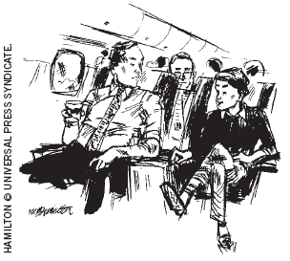
Price Discrimination
Examples of price discrimination
  Movie tickets
    Lower price for children and seniors
  Airline prices
    Lower price for round-trip with Saturday night stay
“Would it bother you to hear how little I paid for this flight?”
© 2015 Cengage Learning. All Rights Reserved. May not be copied, scanned, or duplicated, in whole or in part, except for use as permitted in a license distributed with a certain product or service or otherwise on a password-protected website for classroom use.

Slide 33
Price Discrimination
Examples of price discrimination
  Discount coupons
    Not all customers are willing to spend time to clip coupons
  Financial aid
    High tuition and need-based financial aid
    Willingness to pay
  Quantity discounts
    Customer pays a higher price for the first unit bought than for the last unit bought
© 2015 Cengage Learning. All Rights Reserved. May not be copied, scanned, or duplicated, in whole or in part, except for use as permitted in a license distributed with a certain product or service or otherwise on a password-protected website for classroom use.

Slide 34
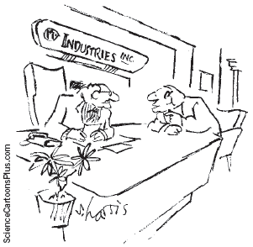
Public Policy Toward Monopolies
Increasing competition with antitrust laws
  Sherman Antitrust Act, 1890
  Clayton Antitrust Act, 1914
  Prevent mergers
  Break up companies
  Prevent companies from coordinating their activities to make markets less competitive
“But if we do merge with Amalgamated, we’ll have enough resources to fight the anti-trust violation caused by the merger.”
© 2015 Cengage Learning. All Rights Reserved. May not be copied, scanned, or duplicated, in whole or in part, except for use as permitted in a license distributed with a certain product or service or otherwise on a password-protected website for classroom use.

Slide 35
Public Policy Toward Monopolies
Regulation
  Regulate the behavior of monopolists
    Price
  Common in case of natural monopolies
  Marginal-cost pricing
    May be less than ATC
    No incentive to reduce costs
© 2015 Cengage Learning. All Rights Reserved. May not be copied, scanned, or duplicated, in whole or in part, except for use as permitted in a license distributed with a certain product or service or otherwise on a password-protected website for classroom use.

Slide 36
Figure 10
Marginal-Cost Pricing for a Natural Monopoly
Price
Average
total cost
Average total cost
Loss
Regulated
price
Marginal cost
Demand
0
Quantity
Because a natural monopoly has declining average total cost, marginal cost is less than average total cost. Therefore, if regulators require a natural monopoly to charge a price equal to marginal cost, price will be below average total cost, and the monopoly will lose money.
© 2015 Cengage Learning. All Rights Reserved. May not be copied, scanned, or duplicated, in whole or in part, except for use as permitted in a license distributed with a certain product or service or otherwise on a password-protected website for classroom use.

Slide 37
Public Policy Toward Monopolies
Public ownership
  How the ownership of the firm affects the costs of production
  Private owners
    Incentive to minimize costs
  Public owners (government)
    If it does a bad job
      Losers are the customers and taxpayers
© 2015 Cengage Learning. All Rights Reserved. May not be copied, scanned, or duplicated, in whole or in part, except for use as permitted in a license distributed with a certain product or service or otherwise on a password-protected website for classroom use.

Slide 38
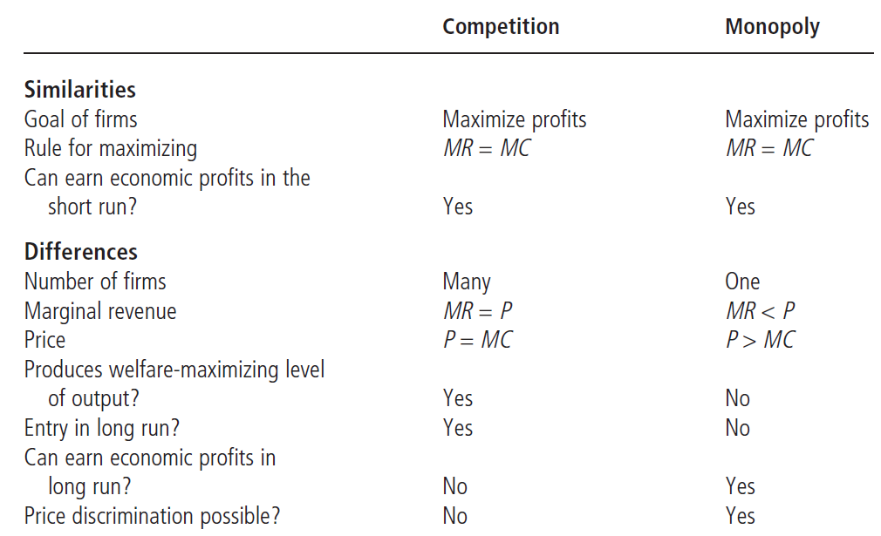
Table 2
Competition versus Monopoly: A Summary Comparison
© 2015 Cengage Learning. All Rights Reserved. May not be copied, scanned, or duplicated, in whole or in part, except for use as permitted in a license distributed with a certain product or service or otherwise on a password-protected website for classroom use.

